Slide 1


Data Handling at ICES
Anna Osypchuk
Hjalte Parner
MUDAB workshop 2025

Slide 2

ICES Data Centre at a glance
30+ managed data flows via dedicated thematic data portals
Unified ICES Data Portal as a joint data access point
Data governance by dedicated expert groups and/or partners
Focus on the data user, with an abundance of targeted data products feeding directly into assessments
Data quality control prior to data submissions
Controlled vocabularies, metadata, documentation
FAIR data

Slide 3
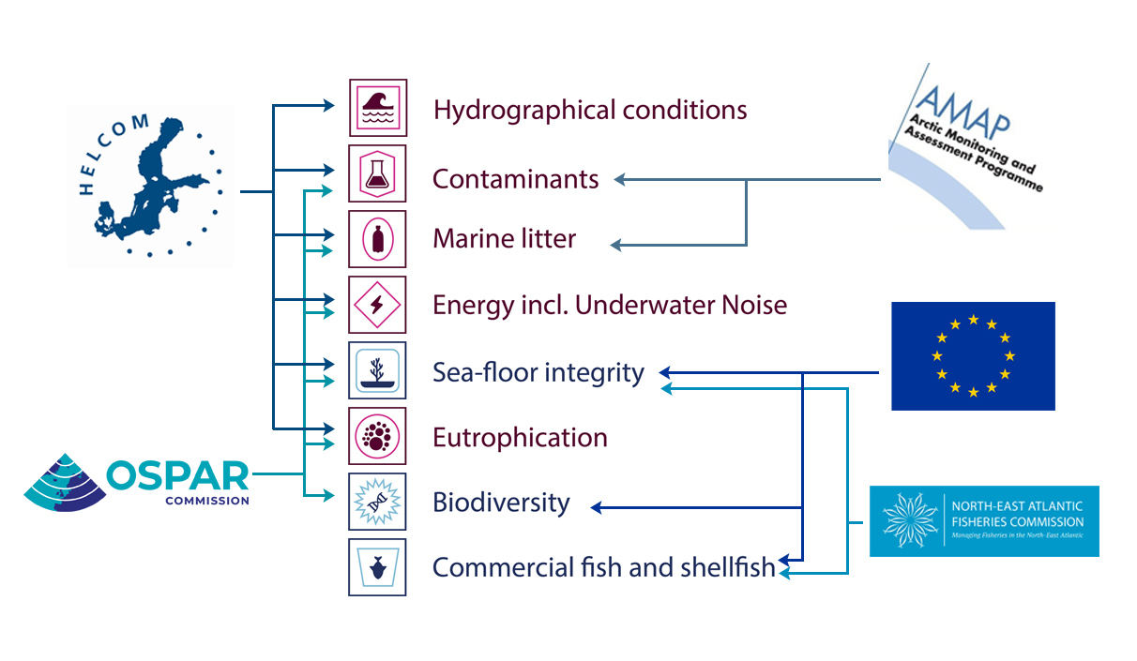
ICES managed data flows

Slide 4
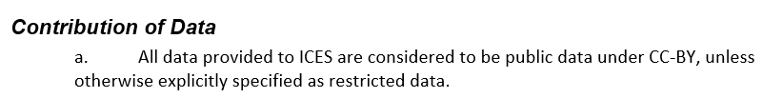
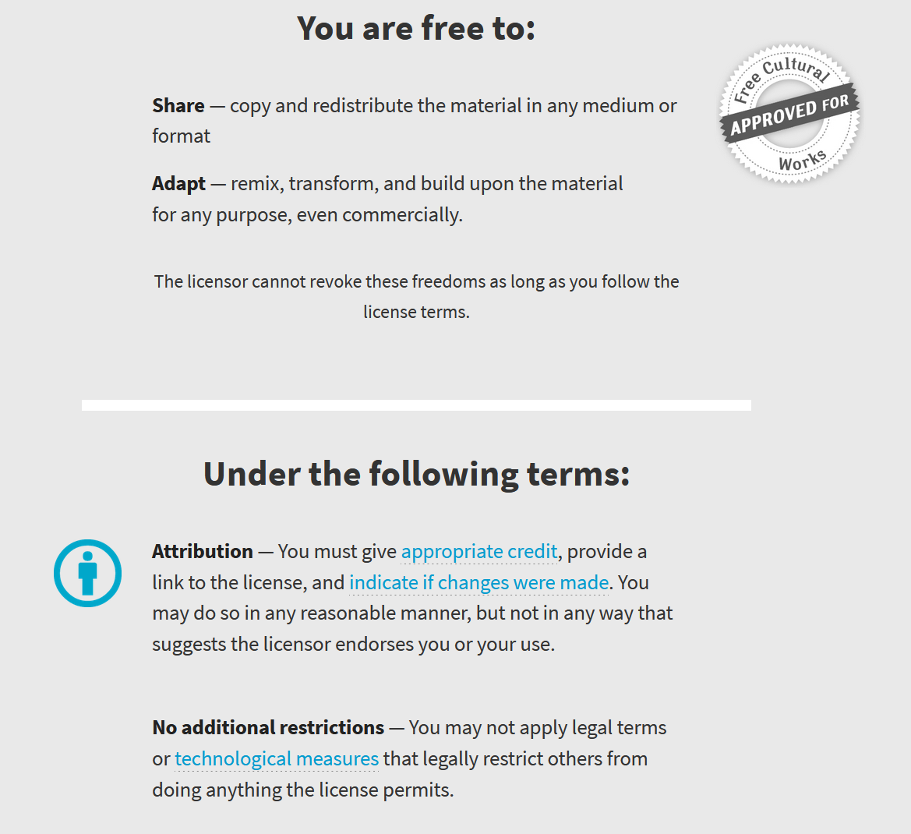






Data Licensing at ICES
Data License
CC-BY 4.0
Restricted data
licenses

Slide 5

Data types from MUDAB to ICES
Hydrographic data – OCEAN Database
Contaminants data (biota, seawater, sediment); Biological Communities (plankton, benthos) data – DOME database

Slide 6

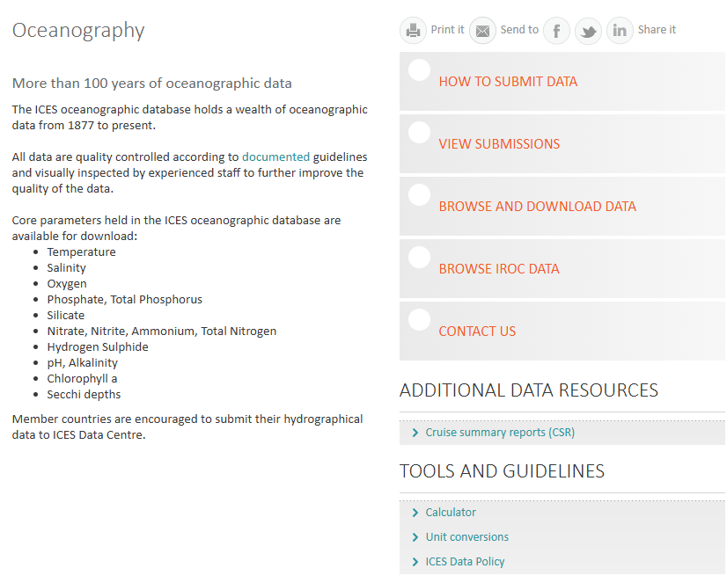
Oceanographic Data Portal https://ocean.ices.dk

Slide 7
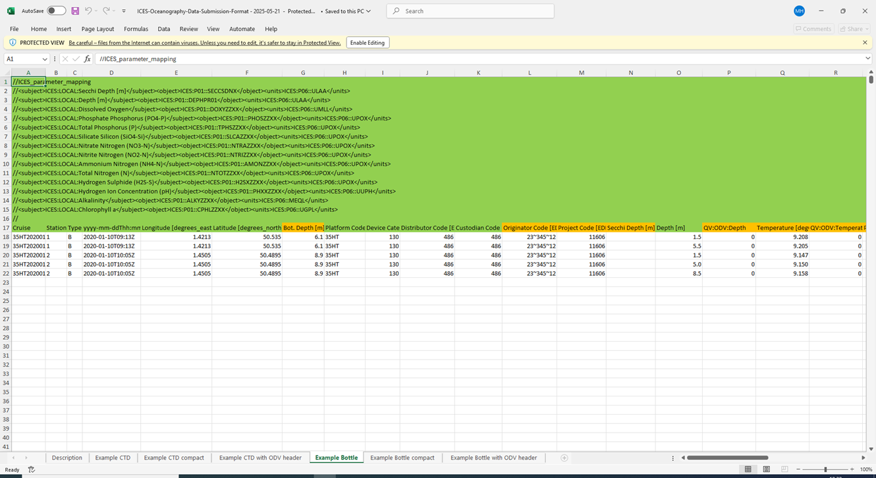
Oceanographic Data Submission Format
Cruise
Station
Type
Year, Month, Day, Hour, Minute, Seconds as ISO8601 Z
Latitude [degrees_north]
Longitude [degrees_east]
Bottom Depth [m]
Platform Code (C17)
Device Category Codes (L05)
Distributor Code (EDMO)
Custodian Code (EDMO)
Originator Codes (EDMO)
Project Codes (EDMERP)
Mandatory Depth [m] or Pressure [dbar]
Optional Parameter [unit] mapped to NERC P01 [P06] in semantic header.
Example…
Temperature [degC] à
<parameter>P01::TEMPPR01</parameter>
<units>P06::UPAA</units>

Slide 8
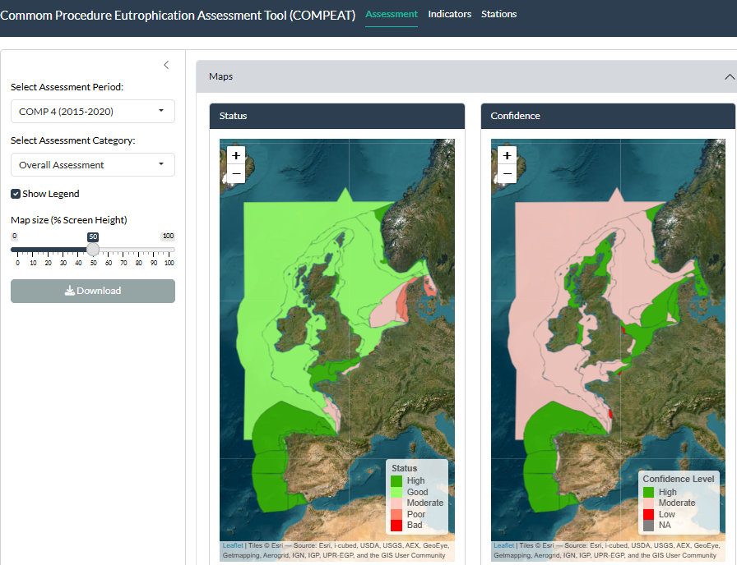
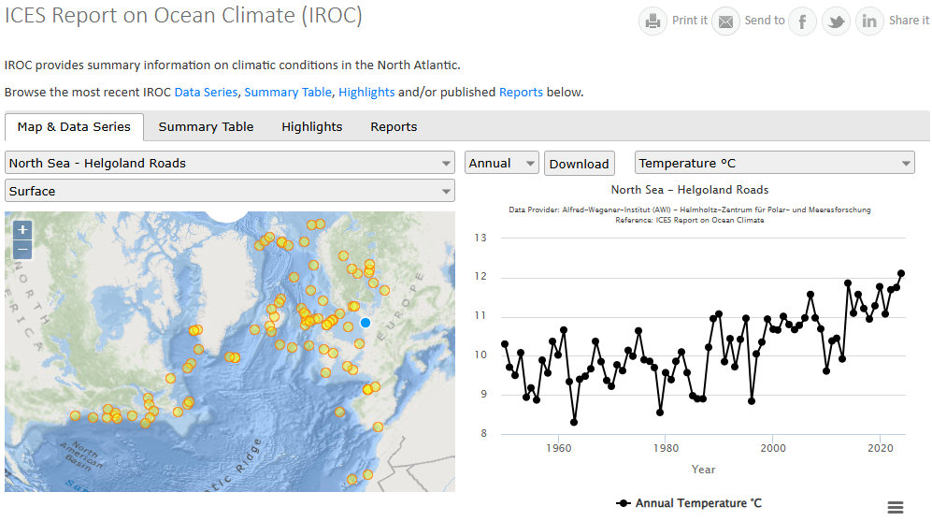
Oceanographic Data Use / Assessments
ICES Data Portal – https://data.ices.dk
ICES Expert, Assessment & Benchmark groups
OSPAR, HELCOM & EEA
Copernicus
SeaDataNet / EMODnet
World Ocean Database
Eutrophication (HEAT, COMPEAT)
Ocean climate (IROC)
Ocean Acidification
Ecosystem overviews
Demersal & Pelagic Fisheries assessments
...

Slide 9
DOME data formats
DOME data formats:
http://ices.dk/marine-data/data-portals/Pages/DOME.aspx
Environmental Reporting Format (ERF 3.2) is a multi-record data submission format for all DOME data types (CF, CS, CW, PP, ZP, ZB, PB, LT)
Simplified formats are excel-based tables created for separate data flows, aiming to decrease the reporting burden for the reporting labs that do not have full-scale electronic databases and extraction programs to tailor the data outputs to ERF 3.2
https://vocab.ices.dk/DataConversion/
ERF 3.2 submission package: 1 CSV/XML file for RLABO, DTYPE, MYEAR. Simplified format can handle multiple years.

Slide 10
DOME data submissions
Submission files are prepared by the national labs according to the format (and assessment) requirements
(conversion to ERF3.2 is made, if needed)
Files are verified in the Data Screening Utility (DATSU)
Work on the screening results is made to eliminate the critical errors and all other messages are checked
When the submitter is happy with the results, the files are sent to accessions@ices.dk
Submission/upload acknowledgement and feedback is received from ICES

Slide 11
DOME data submissions cont.
All submissions and resubmissions are registered at the Accessions and Information Management System (AIMS)
Any corrections and updates in data from the national labs need updates in DOME – data resubmission

Slide 12
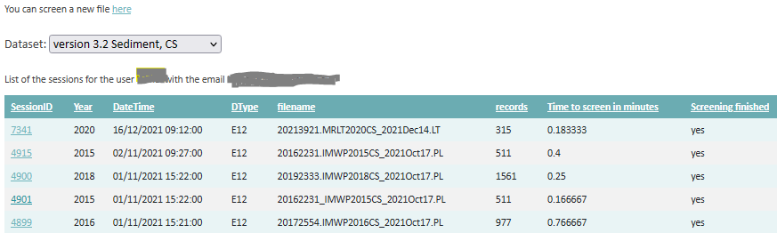
DOME Quality assurance
https://dome.ices.dk/DATSU/
DOME DATSU produces data validation (screening) reports for submitted data, allows to view summary per parameter and matrix, and gives access to the resubmission interface.
DATSU formats and QC rules https://datsu.ices.dk/web/selRep.aspx
QC Database https://www.ices.dk/data/tools/Pages/quality-control.aspx
ICES Vocabulary Server https://vocab.ices.dk/
Station Dictionary https://www.ices.dk/data/tools/Pages/Station-dictionary.aspx

Slide 13
DOME data availability
Submission status summaries: https://www.ices.dk/data/tools/Pages/Submission%20status.aspx
DOME browse: data download by single files http://dome.ices.dk/browse/
DOME Thematic views: data by data type https://dome.ices.dk/views
DOME Webservices, including assessment services
ICES Data Portal https://data.ices.dk/
Primary data uses:
HELCOM, OSPAR, AMAP, EEA
EMODnet
ICES Working Groups
External users, including national authorities.

Slide 14
Data flow schematics
Contaminants data flow schematics https://doi.org/10.17895/ices.pub.25349125.v1
Biological communities and Ocean data flow schematics are in progress

Slide 15

Thank you
Questions?

